Slide 1
Laptop
Computer
TX
Card AC
Card BC
RX

Slide 2
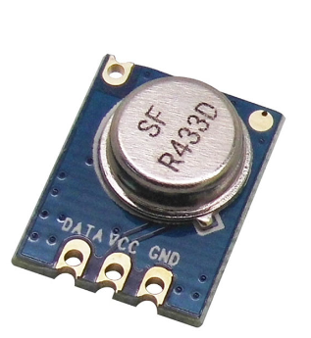
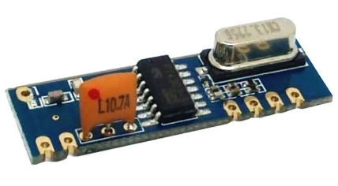
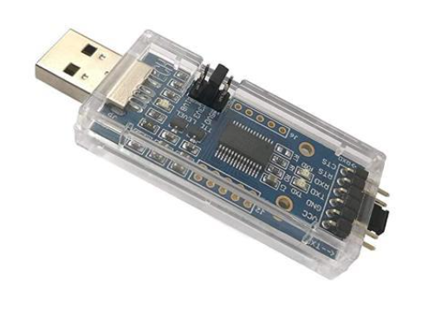
Using UART and Serial Communication
STX882 Transmitter
SRX882 Receiver
Transfer of selected data from the Python interface back to Card A
Intel MAX 10 FPGA named “Card B” is a VLSI Technology Device
Using Serial to Parallel Communication
Laptop
Computer Python Interface
Intel MAX 10 FPGA named “Card A” is a VLSI Technology Device
The data is encoded using BiPhase encoding before being transmitted wirelessly through the STX882 transmitter
Decode the transmitted data stream
Programmed Using Hardware Description Languages Such as Verilog or VHDL
Using BiPhase Encoding for Wireless Transmission
Using BiPhase Decoding after Wireless Reception
Sends a one-byte signal via UART communication through a USB-TTL adapter
The decoded information is organized and displayed on an array of LEDs and an RGB, display on Card B
Performs a CRC8BIT check to verify the integrity of the data
USB-TTL adapter
Using CRC-8, an Error Detection Technique
Using UART and Serial Communication
Using Parallel to Serial Communication

Slide 3

RS232 TX
UART - TX
Synchronization signal
UART - RX
Ram
BiPhase
TX
RS232 RX
BiPhase out

Slide 4
BS_Filter
Simple_BS
NRZL
CRC_8
Bi0s signal
CLK
RGB leds and Control leds
Arrange Control Signal to RGB leds
Data
Organizer

Slide 5
RS232 TX
Uart - tx
Uart - rx
Ram
Read From Ram To SPI Signals
RS232 RX
TX
CC1101
SPI clock
MOSI
Cs

Slide 6
SPI clock
RX
CC1101
RAM
+
LOGIC
CRC_8
MOSI
MISO
Cs
Interrupt
RGB leds and Control leds
Arrange Control Signal to RGB leds
Data
Organizer

Slide 7
Detected Bit
Reset RAM Address
Debouncer
Sampling
N
Y
Y
RAM Address Counter
=
500,000
Debouncer bit = ‘1’
Sampling Counter
=
16
Increment Reset RAM Address Counter
Y
N
Increment Sampling Counter
N
Sampling Counter
=
32
N
Y
Reset Sampling Counter

Slide 8
A
Data Bit
=
0
N
Increment RAM Address
Y
Build RAM Address with Toggle
Reset Data Bits Counter
Increment Sampling Counter
Write Detected Byte to RAM
N
N
Y
Sampling Counter
=
16
Sampling Counter
=
32
Data Bits Counter
=
8
N
Y
Y
Increment Data Bits Counter
Sampling
Reset Sampling Counter
Shift Right Sampled Bit to Detected Byte

Slide 9
State 0
State 1
State 2
State 3
Start Trigger High
Start Trigger Low
Delay
Counter
Receive Constat “CA”
Delay
Counter
State 4
Return to ‘s0’
Right Shift Register
Delay
Counter
Build Data Packet
State 8
State 7
State 6
State 5

Slide 10
State 0
State 1
State 2
State 3
Address Pulse Low
Reading Pulse High
Reading Pulse Low
Coordinate Operations State
Coordinate Operations State
State 4
Address Pulse High
Coordinate Operations State
Coordinate Operations State
State 7
State 6
State 5

Slide 11
N
RAM Address Pulse
=
‘1’
Update RAM Address
Toggle = not Toggle
N
Y
N
RAM Address Pulse
=
‘0’
RAM Address
=
“00000”
Y
RAM Address
=
“00111”
UART trigger = ‘0’
N
Increment RAM Address By 1
Y
UART trigger = ‘1’

Slide 12
N
First 32 Bits (header)
=
X"C0CAFEAB"
Y
CRC Checking & Increment Iterations Counter
Reset CRC Check
N
Iterations Counter
=
216
Correct Data
Y
Y
CRC Check
=
X"00"
Iterations Counter
=
0
N
Incorrect Data

Slide 13
N
First 32 Bits (header)
=
X"C0CAFEAB"
Y
Increment LED Bit Counter & Left Shift NRZL Data to RGB LEDS Signal
Reset LED Bit Counter
Set The First Bits of Green LEDS Register to Represent The Status of The Green LEDs
Load LEDS Pulse Low
Y
N
LED Bit Counter
=
95
LED Bit Counter
=
7
Delay For CRC-8 Operation Completes
Set The Green & RGB LEDS Registers Out to RGB Management Block
N
Y
CRC Check
=
‘0’
Reset LED Bit Counter
Increment LED Bit Counter & Left Shift NRZL Data to Green LEDS Signal
Load LEDS Pulse High
Y
N

Slide 14
RGB Bits Counter
=
96
RGB Bit
= ‘0’
Or
RGB Bit
= ‘1’
Reset OB_LED_RGB_DIN Signal & Increment Delay Counter
Y
N
OB_LED_RGB_DIN Signal
High (‘1’)
N
Delay Counter
=
15,000
Increment RGB Bits Counter
Increment Counter
‘0’
‘1’
Y
OB_LED_RGB_DIN Signal
Low (‘0’)
Reset Delay Counter
Extract Bit From the RGB LEDs Register by Left Shifting
Increment Counter
=
14
Increment Counter
=
36
Y
Y
Load LEDs
=
‘0’ (Low)
Increment Counter
=
50
Send The First Bits of Green LEDs Register to The Green LEDs On Card B
Reset Counter
N
N
Y
Y
N
N

Slide 15
State 0
State 1
State 2
State 3
Start Trigger High
Start Trigger Low
First Byte is “0 0 000000”
Second Byte is the Data From Ram
Chip Select is Low
Start Reading
CC1101 Address = 32
State 10
Shift the First Byte to CC1101
N
7 Times Then CS High
State 4
Delay
Y
State 9
Inc CC1101 Address
Shift the Second Byte Then CS High
Chip Select is Low
Inc Ram Address
State 7
State 6
State 5
State 8

Slide 16
State 0
State 1
State 2
State 3
Start Trigger High
Start Trigger Low
First Byte is “1 0 000000”
Chip Select is Low
Y
CC1101 Address = 159
Shift the First Byte to CC1101
N
7 Times Then CS High
State 4
Inc CC1101 Address
Reading 8 Bits
Chip Select is Low
Delay
State 7
State 6
State 5
State 8

Slide 17
Set The 5 First Byte to Header
Update The 12 RGB Bytes and The Control Buttons Byte to The Control Bars and Buttons Value
Padding The Next 14 Bytes with 0x00
CRC Check on The Data Without The Header
Set The Last Byte of Packet Array to CRC Check Byte
Sending Out
30ms Delay
Print The Packet Array
Print The CRC Check Result Byte

